Slide 1
Comparison of Functions

Slide 2
Agenda
Relationship between O,Θ, and Ω.
Comparison of functions.

Slide 3
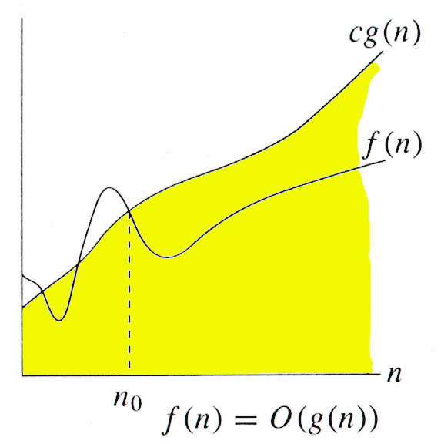
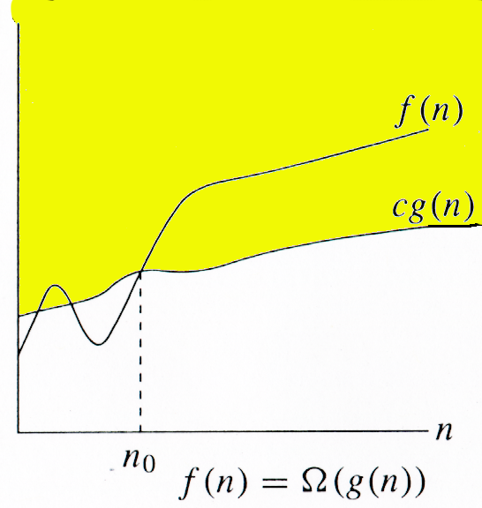
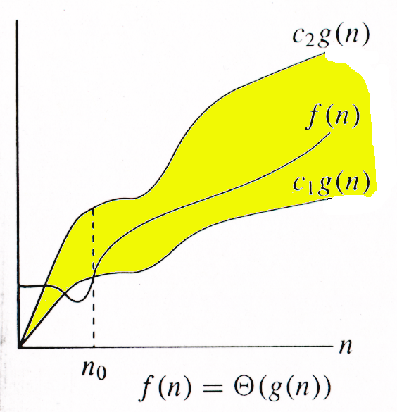
Relationship between O,Θ, and Ω
Example 5n² + 10
Ω(1), Ω(n), Ω(n²) 🡺 lower bounds
Θ(n²) 🡺 exact bound
O(n²), O(n³), ... 🡺 upper bounds

Slide 4
Comparison Of Functions
f ↔ g ≈ a ↔ b
f (n) = O(g(n)) ≈ a ≤ b
f (n) = Ω(g(n)) ≈ a ≥ b
f (n) = Θ(g(n)) ≈ a = b
f (n) = o(g(n)) ≈ a < b
f (n) = ω (g(n)) ≈ a > b

Slide 5
Limits
lim [f(n) / g(n)] < ∞ ⇒ f(n) ∈ Ο(g(n))
^{n→∞}
lim [f(n) / g(n)] = 0 ⇒ f(n) ∈ ο(g(n))
^{n→∞}
0 < lim [f(n) / g(n)] < ∞ ⇒ f(n) ∈ Θ(g(n))
^{n→∞}
lim [f(n) / g(n)] = ∞ ⇒ f(n) ∈ ω(g(n))
^{n→∞}
0 < lim [f(n) / g(n)] ⇒ f(n) ∈ Ω(g(n))
^{n→∞}
lim [f(n) / g(n)] undefined ⇒ can’t comment/say
^{n→∞}

Slide 6
Summary
We have learned the relationship between O,Θ, and Ω
We did a basic comparison of the asymptotic functions in brief and got a wide view on how to use them.

Slide 7
Thank You
Proprietary content. ©Great Learning. All Rights Reserved. Unauthorized use or distribution prohibited

